Slide 1
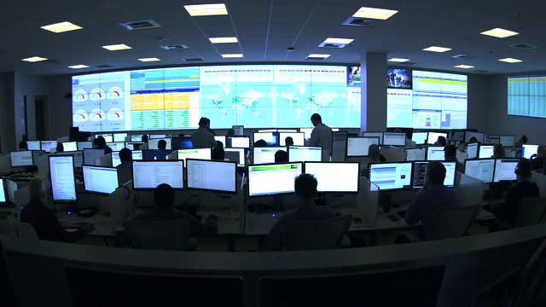
DevSecOps at Microsoft

Slide 2
DevSecOps practices
Assume breach
Credential Theft
Known vulnerabilities in OSS components
War Games
Secure and Compliant Pipeline

Slide 3

Mindset Shift: Assume Breach
“Fundamentally, if somebody wants to get in, they're getting in…accept that. What we tell clients is: Number one, you're in the fight, whether you thought you were or not. Number two,
you almost certainly are penetrated. ”
Michael Hayden
Former Director of NSA & CIA

Slide 4
The Two Widest Back Doors
Credential Theft
Finding Known Vulnerabilities

Slide 5
Credential Theft

Slide 6
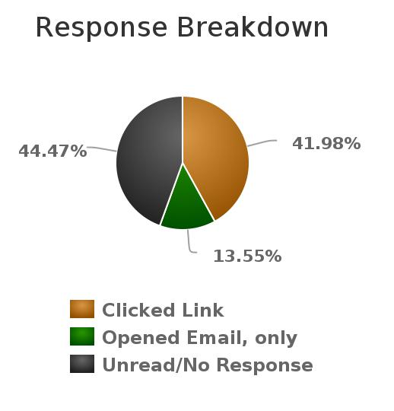
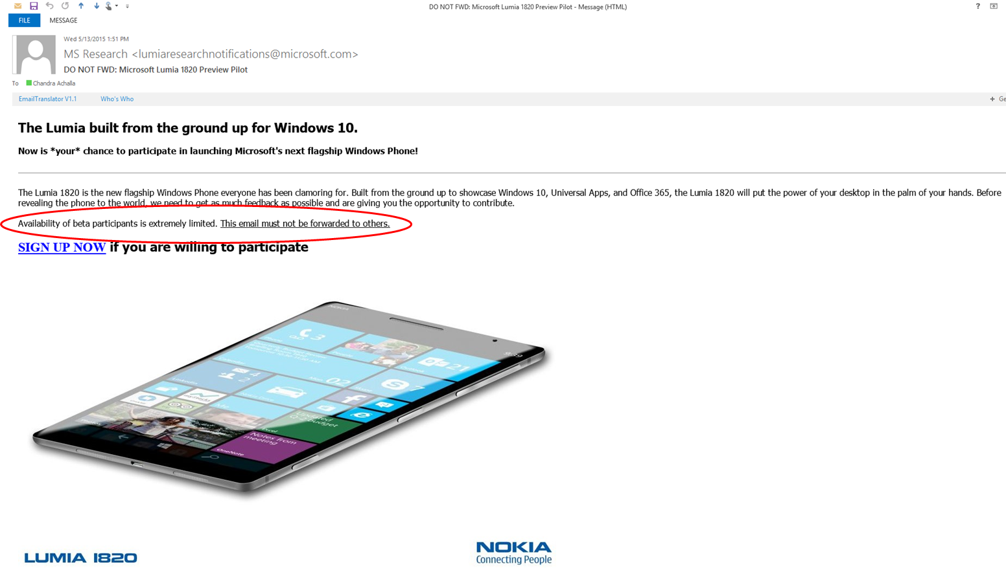
Theft By Phishing
Total population of 524 people.
220 people clicked on signup button. 37 people clicked on both phishing emails
Only 11 people reported to as probable phish

Slide 7
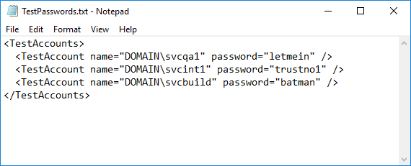
Another Source of Leak: Credentials in a File
What do plaintext credentials look like?
Every team seems to experience this one at the beginning.
Notes:
Every large team that I know of has gone through dealing with this issue. They start red teaming, and the first thing they get is an absolutely humbling report about credentials found on shares. It doesn’t matter if the share is secured – at some point it will become insecure and leaked.
When this first happened to us, Brian’s head exploded. It seems so incredibly stupid, and it is. No one ever set out to be careless and insecure, but it’s tempting.

Slide 8
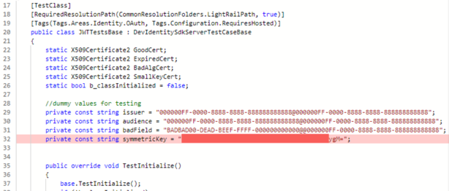
Example: Credentials in Code
Notes:
Whether it is product or test code, credentials in code are a gold mine for attackers. Even worse, they are sometimes in code that becomes open sourced. That’s useful to attackers, but if those credentials provide access to compute in the cloud, it’s a boon for bit coin miners, spammers, etc. who run up the bill on your account!

Slide 9
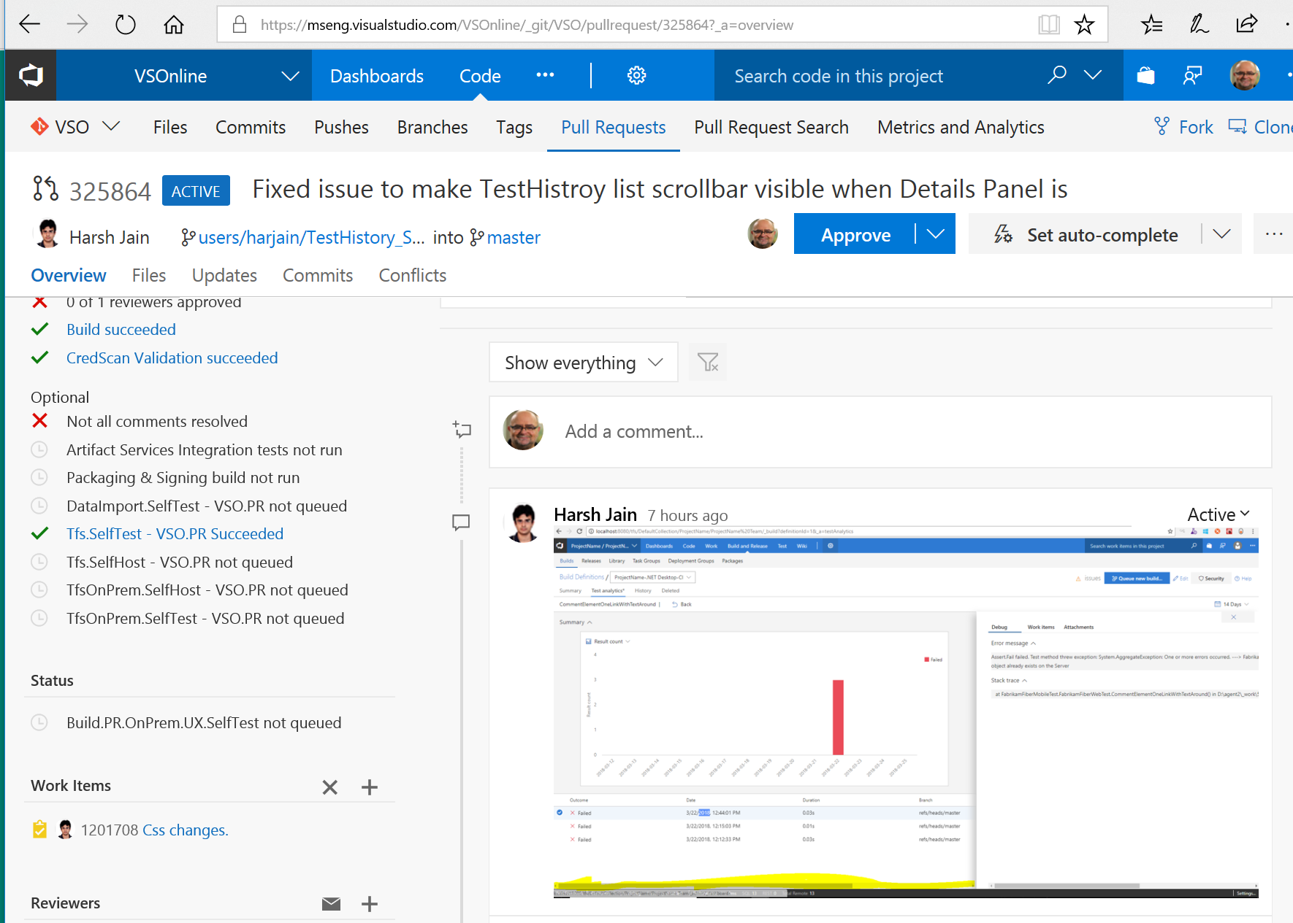
CredScan as Branch Policy on Pull Requests

Slide 10
How We Prevent: CredScan
Scan for credentials and other sensitive content in source files using regex pattern matching.
This includes: access keys, connection strings and certificates.
Useful for scanning shares, code, etc.
<ContentSearcher>
<Name>VstsPersonalAccessToken</Name>
<RuleId>CSCAN0240</RuleId>
<ResourceMatchPattern>\.(cs|ps1|bat|config|xml|json)$</ResourceMatchPattern>
<ContentSearchPatterns>
<string>AccessToken.*?['="][a-z0-9]{52}('|"|\s|[\r\n]+)</string>
<string>[>|'|=|"][a-zA-Z0-9/+]{70}==</string>
<string>password\s+[a-z0-9]{52}(\s|[\r\n]+)</string>
</ContentSearchPatterns>
<MatchDetails>Found Vsts personal access token in source file.</MatchDetails>
<Recommendation>Validate file contains secrets, remove, roll credential, and use approved store.</Recommendation>
<Severity>3</Severity>
</ContentSearcher>
Currently Microsoft internal only, with a plan to make an extension available to customers
Notes:
How can I detect credentials on shares, code, etc.? CredScan

Slide 11
Known Vulnerabilities in Open Source Components

Slide 12
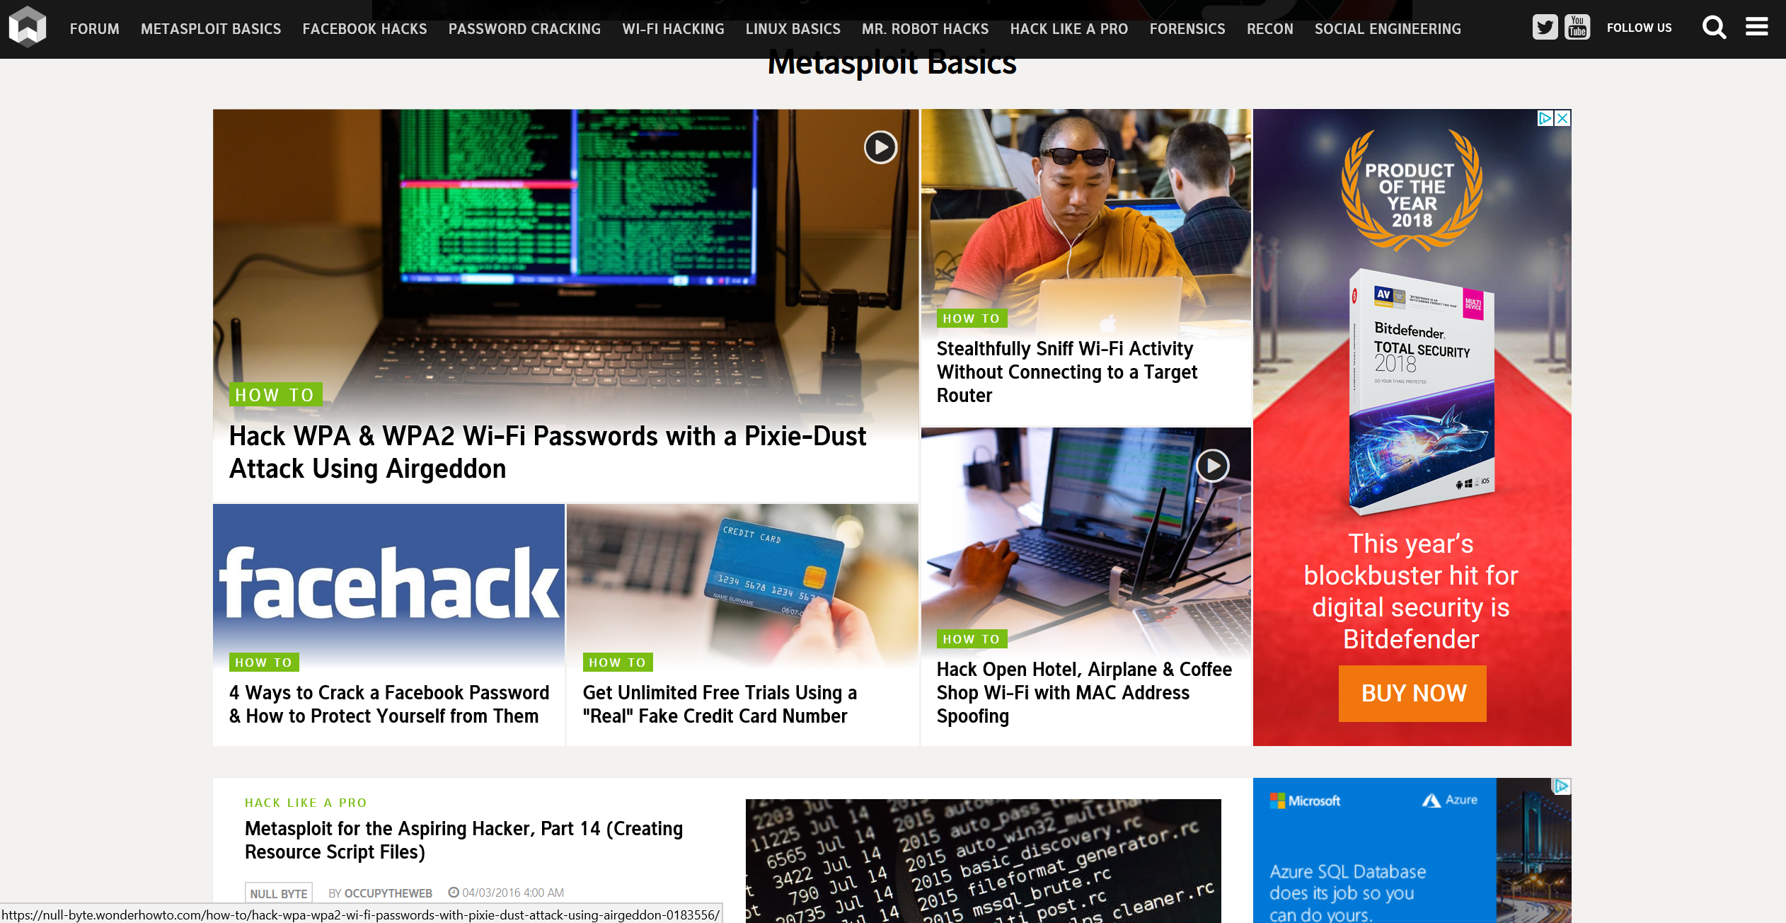
How to Find Known Vulnerabilities

Slide 13
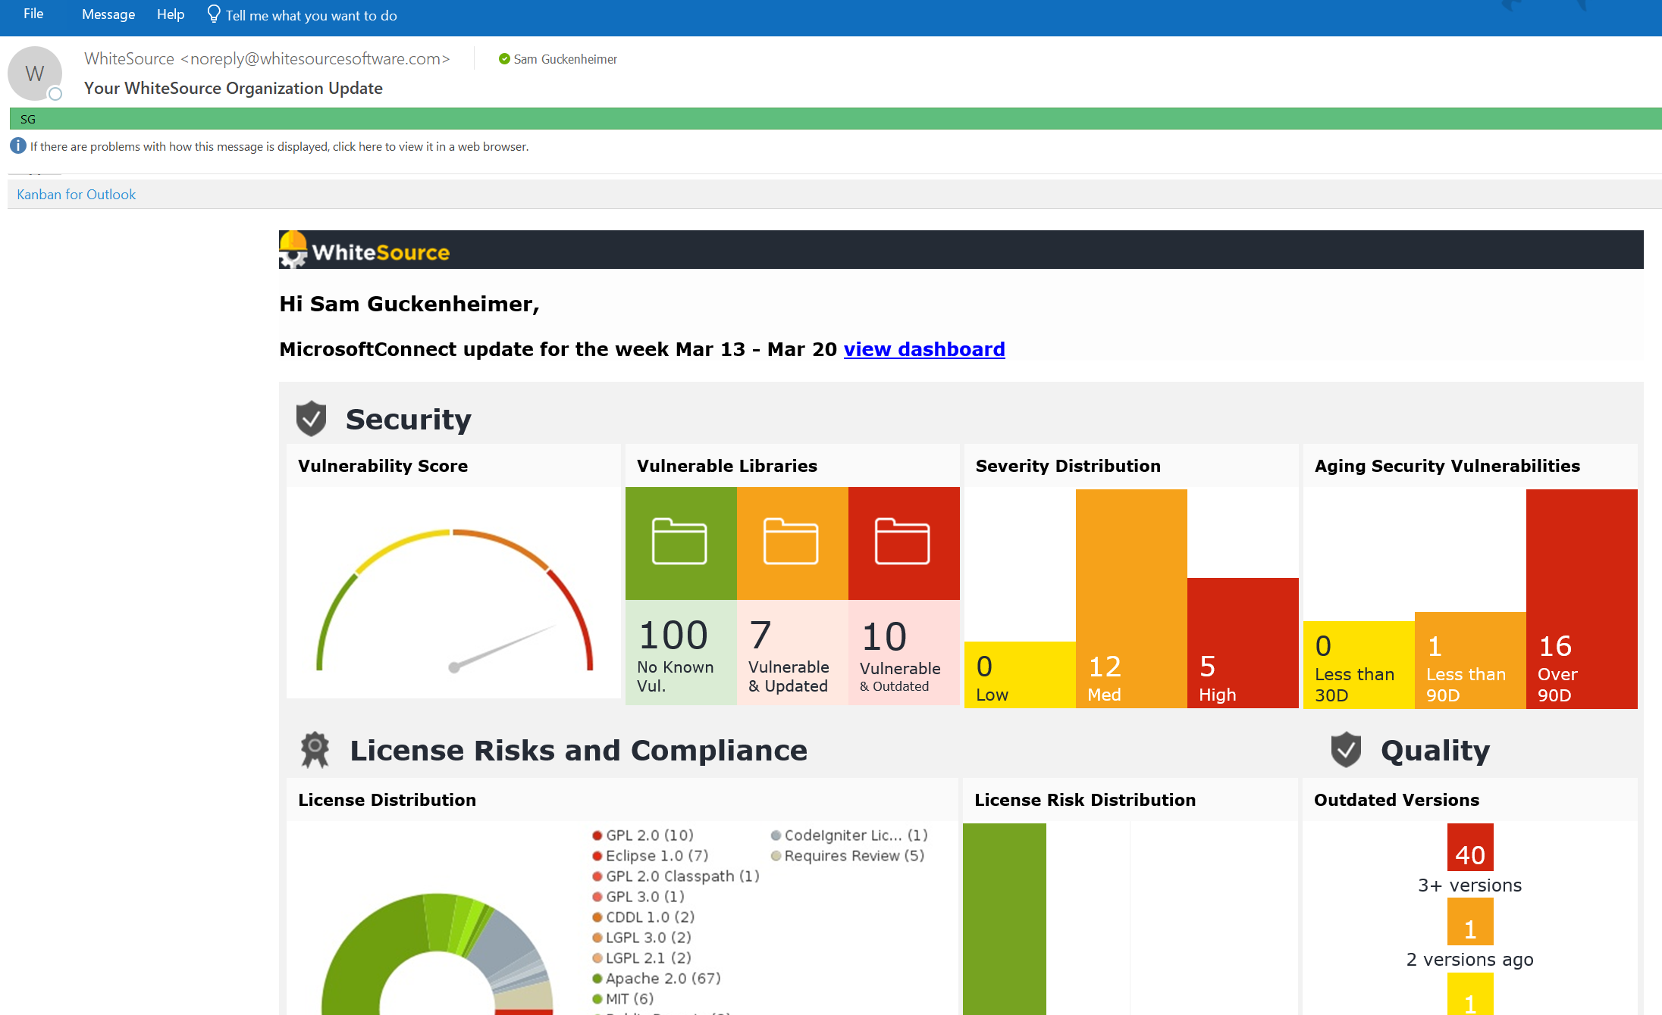
Scan All Your OSS Components and Subscribe to Notifications

Slide 14
Package Management
Binary artifacts are accessed via a trusted feed and scanned for vulnerability
Builds produce artifacts that are managed
OSS dependencies are scanned for vulnerabilities and kept up to date

Slide 15
War Games

Slide 16

Red Teaming
vs.
 Double blind test
 Full disclosure at or near end
 Share tactics & lessons learned
 Continued evolution

Slide 17
Our Red Team Guidelines
Code of Conduct
Both the Blue Team and the Red Team will do no harm.
The Red Team should not compromise more than needed to capture target assets.
Common sense rules apply to physical attacks (no printing badges, harassing people, etc.)
Do not disclose the name of the person who was compromised in a social engineering attack.
Rules of Engagement
Do not impact availability of any system.
Do not access external customer data.
Do not significantly weaken in-place security protections on any service.
Do not intentionally perform destructive actions against any resources.
Safeguard credentials, vulnerabilities and other critical information obtained.
Deliverables
Backlog of repair items (security item SLA)
Report “read out” with entire organization as a learning opportunity.
Notes:
The guidelines are very important. We must not cause our external customers harm during this process.

Slide 18
Our Evolution of Red vs. Blue
Earlier
Identify vulnerabilities through manual code review
Engage external pen testing company
Report out to the team, fixes added to the backlog
2015
Paired a handful of security-minded engineers with a pen tester (Red team)
A few ops-minded engineers that understand the systems & logging available (Blue team)
Attacks were successful due to poorly protected secrets, SQL injection & successful phishing campaigns
2016
Augment both teams with outside experts (AD security and IT Security Incident Response experts)
Comprehensive, centralized logging available for Blue team to do post-breach forensics
Attacks were based upon Cross-site scripting (XSS), deserialization, & engineering system vulnerabilities
2017
Red team taking longer to reach objectives. Forced to find & chain 5-6 different vulnerabilities together
With Kalypso monitors, Blue team is starting to catch Red team in real-time
Notes:
The earliest attempts helped us identify engineers on the team who were good at attacking the product
One early example was the use of the “barred O” Cyrillic character to exploit the differences in how .NET compares strings vs. SQL Server. That exploit allowed elevating from the lowest privilege in the system to admin.
In 2015, we hired a good pen testing firm. They were expensive, but this is a case where you get what you pay for. We learned from them.
We found our first issues, from secrets on file shares to the effectiveness of phishing attacks.
We also learned that the system is too complex for someone to ramp up in a short time and then be able to string together vulnerability exploits into a kill chain.
Detection was non existent.
Most interesting SQL injection vulnerability was exploited within a constraint that allowed only 38 characters and used temp tables to form an executable string (SQL stored in a table can no longer be executed as a result of that exploit).
In 2016, we started asking for help from other red teams in the company and getting one or two people with expertise in different things, from infrastructure to Azure
This helped us learn about the methods and tools that other red teams in the company are using
Stopped having a blue team spun up for the event. Real attacks don’t come with warnings! Switched to blue being forensics.
In 2017 the red team started to have to work harder to break in, but they still got in.
We started detecting them more often.
By the way, you may notice that the red team always wins. It’s a lot of fun for the folks on the red team.

Slide 19
Threat Modeling

Slide 20
Why Threat Model?
A way to identify security issues during design
Developers think about how a product works
Attackers think about how to abuse a product
Shift the mindset
Think like an attacker
Notes:
Most developers and product owners are not “in the trenches” defending against attackers on a daily basis. Their primary focus is delivering new products and features.
Without threat modeling, they will routinely miss potential threats or underestimate the motivations and capabilities of attackers.
To design and build secure systems, one must shift the focus from:
how products should work to how products might be abused.
Threat modeling encourages you to think like an attacker so you can identify threats and take steps to mitigate them before your product ships.
It surfaces security development tasks and design flaws early. This allows for careful planning and avoids risk to the project schedule.
It serves as a test plan for validating that your system is secure.
It makes a business aware of security risks and helps to prioritize them.

Slide 21
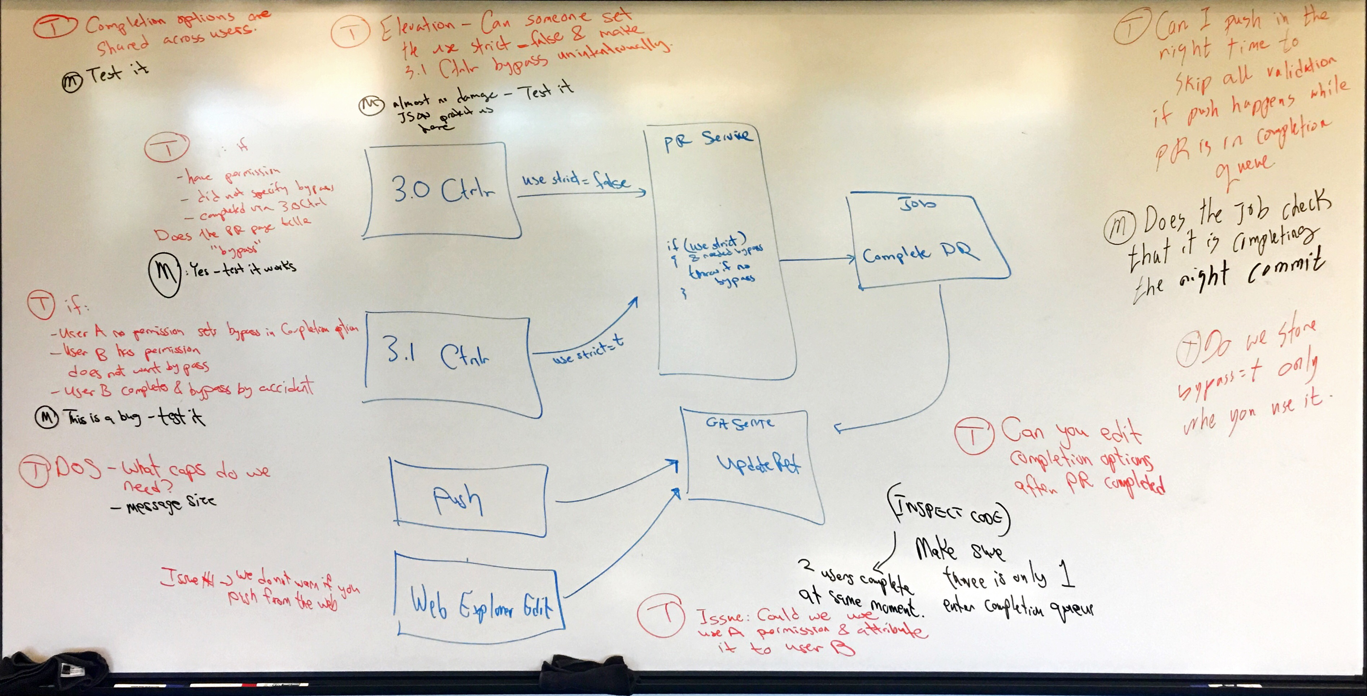
Threat Model: Pull Request Bypass
Notes:
T: a threat
M: a mitigation
PM: a potential mitigation (either not implemented yet or needs to be confirmed)

Slide 22
Tips
Large whiteboard
Prepare a list of use cases ahead of time
Add backlog items during or right after
Don’t auto-generate threats – too noisy
Build on past threat models
Notes:
Get a room with lots of whiteboard space.
Prepare the list of use cases and (if possible) a first draft of DFDs in advance.
Add backlog items for mitigations during or shortly after the meeting.
Record action items when issues need to be researched. (e.g. I think the foobar service encrypts the data we pass to it but I should ask the foobar team to be sure…)
Don’t auto-generate threats in the threat modeling tool—this results in lots of bogus threats that will waste analysis time and hide the important ones.
Iterate on your existing threat model as you add new product features but always save archival copies of earlier versions created for product versions you ship. Auditors like this.

Slide 23
Block Lateral Movement

Slide 24
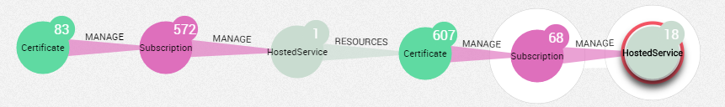
“Defenders think in lists. Attackers think in graphs. As long as this is true, attackers win” -- John Lambert (MSTIC)
Notes:
This notion of thinking in graphs is critical. It’s the reason some issue that doesn’t seem significant matters. Any issue that can be used as part of a kill chain is important.
John Lambert: https://blogs.technet.microsoft.com/johnla/2015/04/26/defenders-think-in-lists-attackers-think-in-graphs-as-long-as-this-is-true-attackers-win/

Slide 25

Example: Red Team Attack
Open File Share
Plaintext Test Credentials
Dev box with Test Account as Local Admin
Mimikatz Credential Dump
Dev’s Credentials
Notes:
Gain credentials to some identity.
Find a machine where it is admin.
Log in, run mimikatz, steal more credentials
Repeat process

Slide 26
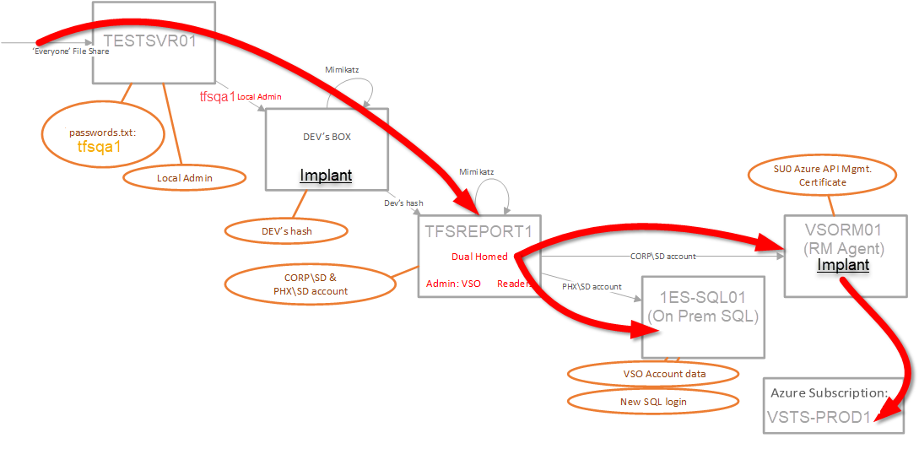
Example: Red Team Attack with Lateral Movement

Slide 27
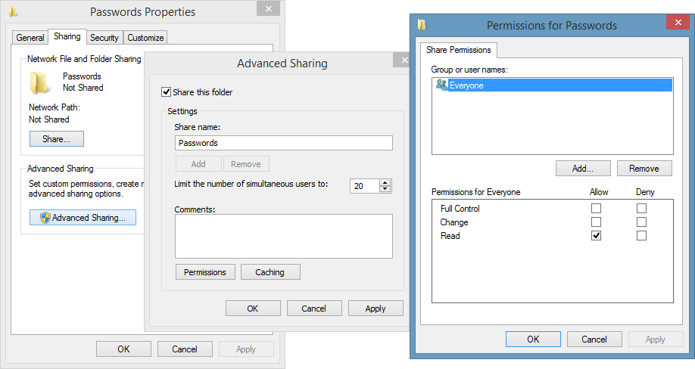
Example: Red Team Attack
What does an unprotected file share look like?

Slide 28
Defense in depth
Attackers chain vulnerabilities together
Move from one system to another
Assume layers before yours will be breached
Never assume an internal service is unimportant
Notes:
Attackers don’t just exploit a single vulnerability and call it quits.
They chain multiple vulnerabilities together, pivoting from one target system to the next until they achieve their objective (or get caught.)
Each layer of the system must be secured independently.
assume that other layers’ security controls will be bypassed or disabled.
Don’t be like this guy!
“I don’t need to worry about securing my web service since it
runs in the data center and isn’t exposed to the public Internet!”

Slide 29
Secure and Compliant Pipeline

Slide 30
Refresh the Infrastructure Regularly
Attacker’s goal is plant command and control inside your network
PaaS and Regular Deployment from Infra as Code (e.g. ARM) refresh the infra and wash out the places to hide
Encrypt by default in transit and at rest

Slide 31
Source Control / Branching policies
Single Master/Trunk-based development
Commits to Master only through Pull Request
No direct pushes

Slide 32
Secrets Management: Azure Key Vault (AKV)
All secrets must be stored in AKV:
Passwords, keys, tokens
Storage Account keys
Certificates
Credentials used in Test too
Hierarchy of vaults to eliminate duplication of secrets.
Vaults available at run-time so that secret changes propagate instantly.
Service Instance
Run-time vaults
Deploy-time vaults
Service-wide vault
Global vault
Deployment-specific vault
Service-wide vault
Global vault
Deployment-specific vault
Notes:
Changing secrets does not require a deployment for runtime secrets
Being able to update secrets immediately (without a deployment) is critical in order to be able to react to a secret being leaked.

Slide 33
Progressive Exposure
Changes/Deployments/Releases are systematically exposed to traffic progressively (by ring and/or identity)
Changes can be turned off or rolled back based on telemetry
Dynamic scanning of all services on Azure

Slide 34
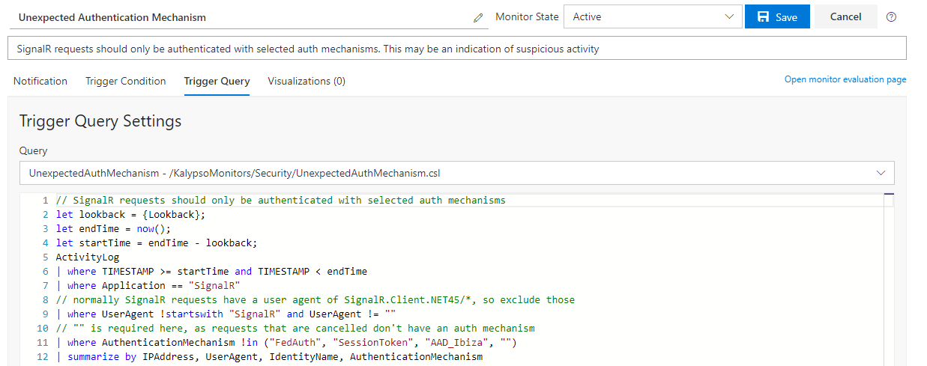
Kalypso (Internal today) for Security Monitoring
Azure Security Center is great for generic infrastructure alerts (malware, suspicious processes, etc).
Kalypso monitors are great for team-specific or application-specific monitors.
Enable rapid iteration and onboarding of new monitors against specific threats.
Notes:
Kalypso is an internal service for monitoring. One of the things it does is run queries against Azure Log Analytics on a schedule. When that query returns a non-empty result set, it triggers an alert.

Slide 35
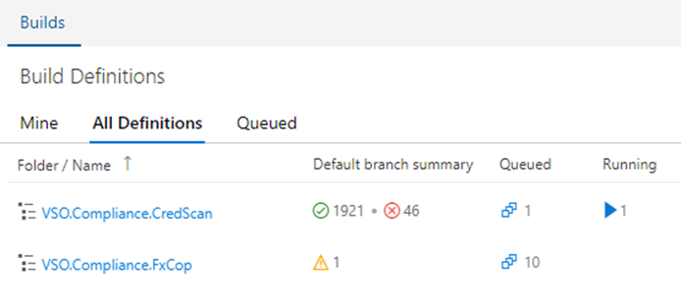
Pipeline Security Tools
Tools
CredScan
BinSkim
WebScout
SSLScanner
Open Source Software Compliance
One Compliance (1CS)
Other Tools

Slide 36
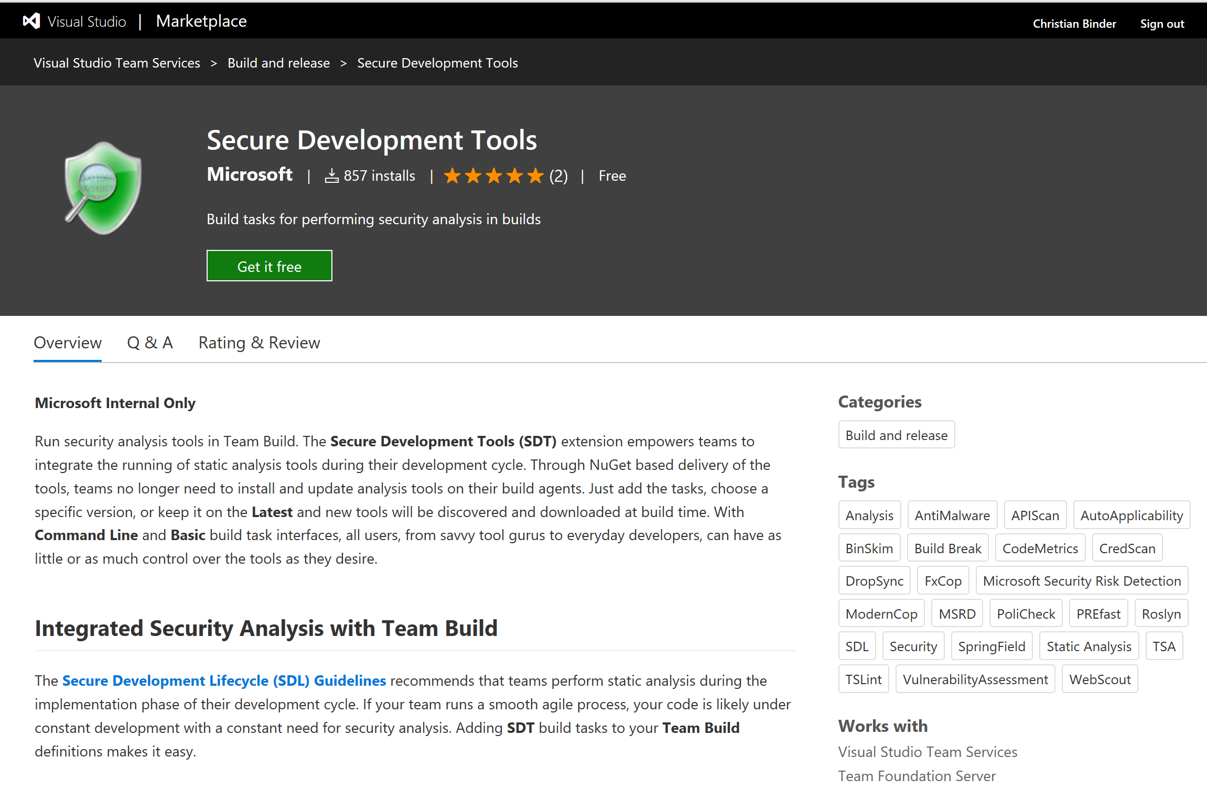

Slide 37
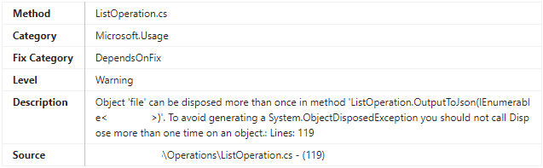
FxCop / Code Analysis
Code analysis for managed code.
Customized ruleset which includes security rules and code quality rules.
Code Analysis is included in Visual Studio

Slide 38
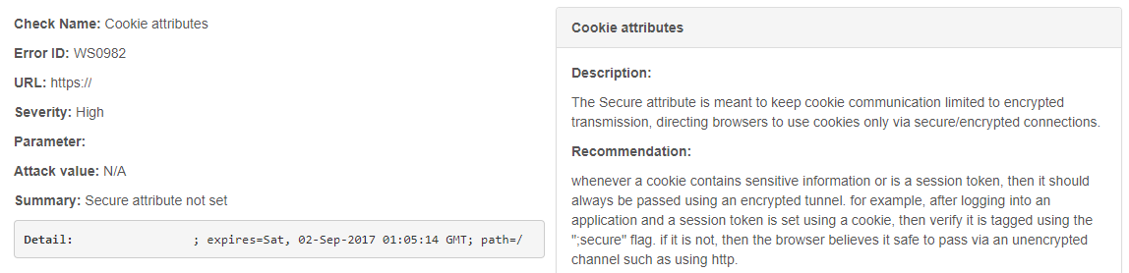
WebScout
A web application vulnerability scanning service that checks for OWASP Top 10, Privacy, SDL, SQL Injection and Cross-Site Scripting (XSS) issues.
SDL checks include: Banned Library Version, Blind SQL Injection, Clients Cross-Domain Policy Files
Cross-site tracing (XST), DOM based Cross-site scripting (XSS), Header Checks, HttpOnly attribute, JS Document Domain, Persistent Cross-site scripting (XSS), Reflected Cross-site scripting (XSS), Remote Resource Inclusion, Secure attribute, SQL Information Leakage, SQL Injection, SQL injection Auth Bypass, SQL Parameter Check, & Unvalidated URL Redirect
Microsoft internal only abstraction over 3rd party technologies Microsoft has licensed (Rapid7 Appspider)

Slide 39
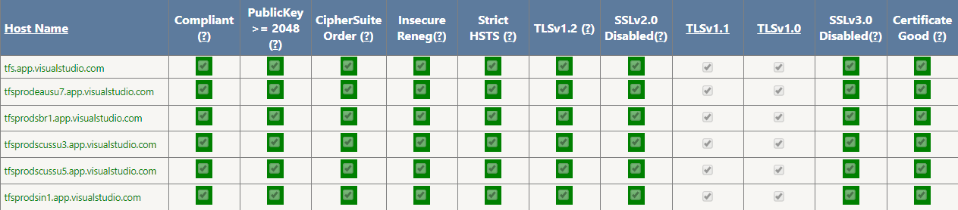
SSLScanner
Check TLS / SSL configuration of servers to ensure they comply with Microsoft’s encryption-in-transit policies. These include: 2048-bit key lengths, Perfect Forward Secrecy ciphers, HTTP Strict Transport Security headers (HSTS) and insecure protocols disabled.
Microsoft internal only equivalent of Qualys https://www.ssllabs.com/ssltest/

Slide 40
No Standing Permissions
No access to production
JIT tokens only
PowerShell Just Enough Administration
Secure Workstation only

Slide 41
In Production
Content Security Policy to prevent XSS
Machines always patched to latest security patches and virus detection
Only approved and signed binaries allowed to run (AppLocker)
Machines monitored for unexpected user / group changes
Monitor various auth schemes to look for suspicious patterns
Host Intrusion Detection System
Threat Detection
Security Incident Response & Management
WAF
Threat Intelligence
Others…

Slide 42
Practices Summary
Assume breach!
Protect Credentials from theft
Scan OSS components for vulns and keep up-to-date
Red-team war games
Secure and Compliant Pipeline

Slide 43
Practices Summary
Assume breach!
Protect Credentials from theft
Scan OSS components for vulns and keep up-to-date
Red-team war games
Threat modeling
Block lateral movement
Secure and Compliant Pipeline

Slide 44
Sudharshan Bommu
subommu@microsoft.com
Thank you!

